Slide 1
SUPERMARKET CUSTOMER
SEGMENTATION
Participants:
Gravias Marios
Tragakis Tilemachos
Chalepas Konstantinos

Slide 2
MISSION STATEMENT
Our goal is to provide insights to our business partners about their customers, enabling them to make data driven decisions.

Slide 3
The Data
Demographics
Spending Habits
Age, Marital Status, Income etc.
Amount of $ spent on different product categories
Promotion
Purchasing Habits
Number of accepted offers from campaigns
Number of purchases from different channels (Web, Catalog or Store)

Slide 4
OUR PROCESS
Feature Engineering
01
03
02
Data Cleaning Preprocessing
Dimensionality Reduction

Slide 5
OUR PROCESS
Evaluation
04
06
05
Clustering Customer Segmentation
Profiling

Slide 6
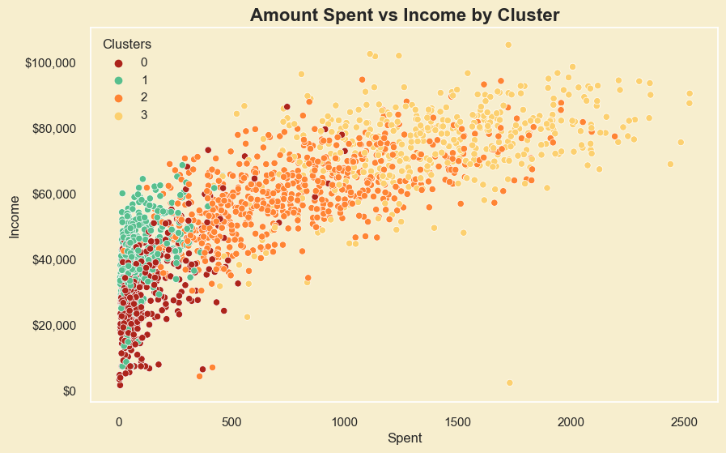
Customer Segmentation
Our clustering analysis revealed 4 significant customer profiles, offering insights for targeted marketing strategies.

Slide 7
Low Earners / Low Spenders (Group 1)
$105
Education
Under
Graduate
Post
Graduate
Average spend per customer within a 2 year period
Age
Buying Habits
Offer Acceptance
Rate
44
50% Store
40% Web
10% Catalog
Income
9%
~$30,000

Slide 8
Mid Earners / Low Spenders (Group 2)
$125
Education
Under
Graduate
Post
Graduate
Average spend per customer within a 2 year period
Age
Buying Habits
Offer Acceptance
Rate
56
53% Store
36% Web
11% Catalog
Income
9%
~$42,000

Slide 9
High Earners / Mid Spenders (Group 3)
$817
Education
Under
Graduate
Post
Graduate
Average spend per customer within a 2 year period
Age
Buying Habits
Offer Acceptance
Rate
56
45% Store
36% Web
19% Catalog
Income
23%
~$60,000

Slide 10
High Earners / High Spenders (Group 4)
$1,390
Education
Under
Graduate
Post
Graduate
Average spend per customer within a 2 year period
Age
Buying Habits
Offer Acceptance
Rate
52
43% Store
26% Web
31% Catalog
Income
42%
~$76,000

Slide 11
Summary
>90%
46%
15%
of Total Revenue is generated by Groups 3 and 4
Of Purchases are made through physical Stores
of Total Revenue is generated through offers

Slide 12
Outlook
4 major clusters of customers
1: Low Earners / Low Spenders
2: Mid Earners / Low Spenders
3: High Earners / High Spenders
4: High Earners / Mid Spenders
Key achievements:
Produced valuable insights to increase business profit through:
Better targeted marketing
Enhanced product orders management minimizing waste & predicting demand trends more accurately

Slide 13
Outro
We are looking forward to continuing our partnership in shaping a more effective retail landscape!

